Slide 1

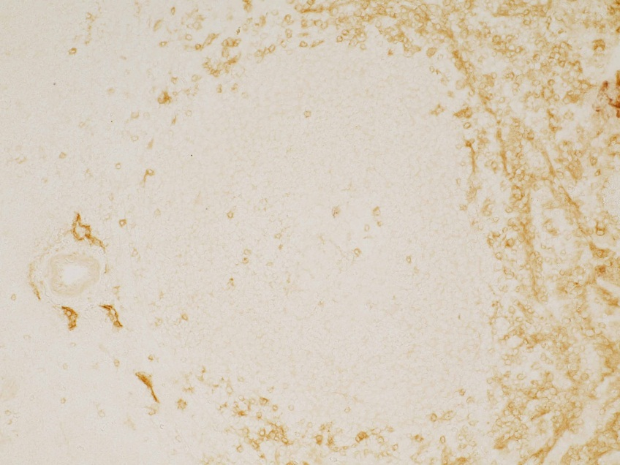
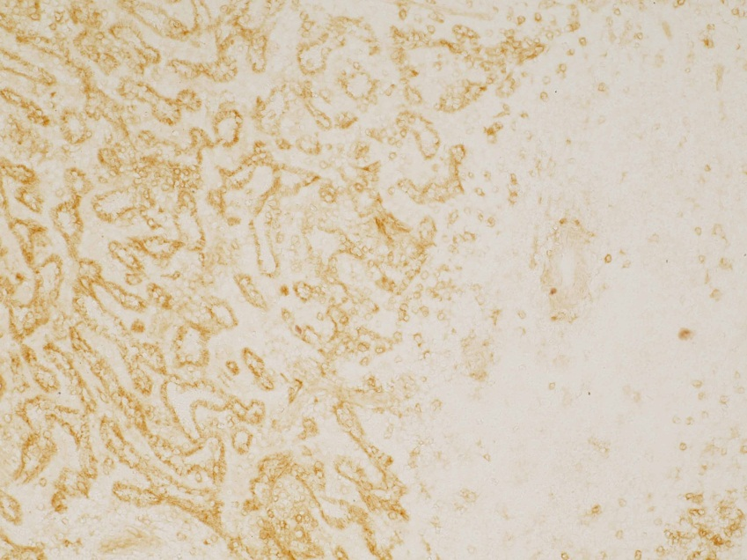
RELIATech GmbH
Anti-human VEGFR-3/FLT-4
(Cat# 102-PA22S / -PA22)
Human Spleen (cryo section)
Anti-human VEGFR-3/FLT-4 (Cat# 102-PA22S)
Human Spleen (cryo section)
Anti-human VEGFR-3/FLT-4 (Cat# 102-PA22S)
The experiment was performed by Prof. Dr. Birte Steiniger, Institute of Anatomy and Cell Biology Robert-Koch-Str. 8, D-35037 Marburg, Germany
http://www.reliatech.de / info@reliatech.de

